Slide 1
Deep Learning Activation Functions
by:
Dr. Muhammad Safyan
.

Slide 2
Outline
Sigmoid Function
Pros and Cons
Tanh
ReLU
Leaky ReLU
ELU

Slide 3
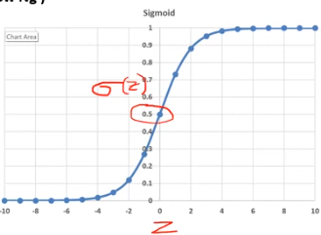
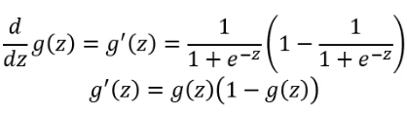
Sigmoid σ
Notes:
Can t creat deep NN

Slide 4
Sigmoid σ
Smooth gradient, preventing jump
Range(0, +1), Normalizing the value of each Neuron.
Clear prediction (0,1)
Gradient vanishing problem → 0 for higher value of z
Power operation is relatively time consuming
Mean round 0 , Less optimal in NN
Very less used in NN
Derivative:
Notes:
Can t creat deep NN

Slide 5

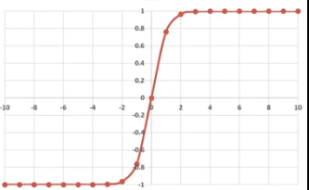

Hyperbolic Tangent(tanh)

Slide 6
Hyperbolic Tangent(tanh)
Shifted version of sigmoid
Range(-1, +1)
0 centric
Same Vanishing Gradient Problem→0
Derivative:

Slide 7

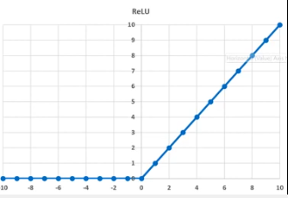
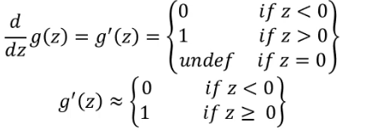
Rectified Linear Unit(ReLU

Slide 8
Rectified Linear Unit(ReLU
Range(0, infinity)
solve Vanishing Gradient Problem for higher value of Z.
Grandient undefined for z=0 and z when z<0
Relue dies when having value negative
Derivative:

Slide 9

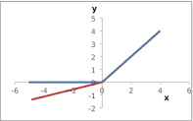
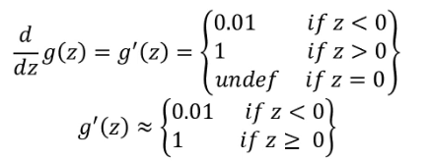
Leaky ReLU

Slide 10
Leaky ReLU
Range(-∞, ∞)
solve Vanishing Gradient Problem for higher value of Z.
Gradient is undefined for z=0 and z
Solve dead neuron problem
Derivative:

Slide 11

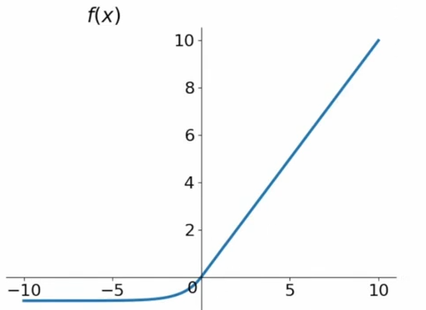
ELU-Exponential Linear Unit
Range(0, 1)

Slide 12
Use of Activation function
Which activation function should used
with sigmoid and tanh → vanishing Gradient descent.
With Binary classification
With hidden layer use Relu/ELU/PRelu and in output layer use sigmoid activation function.
with Multi classification use SoftMax activation function in output layer , hidden layer will be same.
With Regression use Relu for hidden layer and Linear activation function for output layer.

Slide 13
Loss function
Cross entropy for Binary classification

